Slide 1
Blockchain for federated learning
Sreya Francis, Martinez Ismael

Slide 2

Current Scenario

Slide 3
Existing technology - Issues
Data collection means adopted right now is incredibly privacy invasive
We give our data for free in return of a free service
Latency issues
High transfer costs
Centralized ownership (Users don’t participate in the current system)
Very limited data for healthcare research

Slide 4
Current Issues
Privacy Concerns
We don’t have control over the data we generate!
We are losing one source of natural income
Data is our natural resource and we own it
Sensitive Product Problem - some services are creepy
High risks of theft, embarrassment, resale ……etc
Centralized control by Big Tech Giants
All of our data are controlled by tech giants like google, facebook

Slide 5
How can we solve this?
Enhance user privacy
We should control our data
We should be rewarded for the data we own
Rewards based on data quality and quantity
Decentralized power
Everyone has control over their data
Enhance production of sensitive products/models
Enhanced privacy would make it easier to collect data related to sensitive fields like healthcare

Slide 6
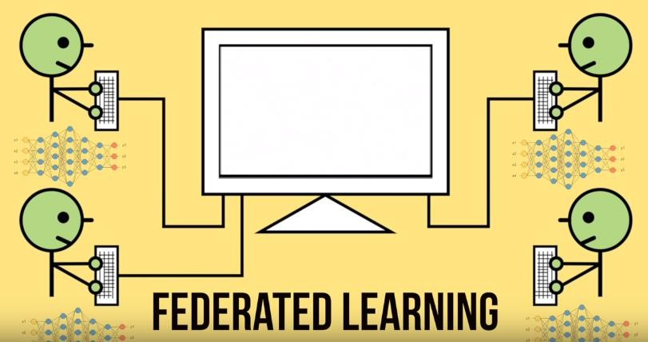



Ingredients for the solution
Federated Learning BlockChain
Internet of Things
Cryptography

Slide 7
1
Federated Learning
What is Federated Learning?
How does it work?
Federated Learning Platforms

Slide 8
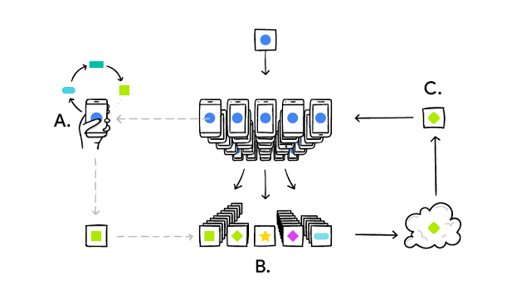
Federated Learning - Definition
Idea: machine learning over a distributed dataset
Federated computation: where a server coordinates a fleet of participating devices to compute aggregations of devices’ private data.
Federated learning: where a shared global model is trained via federated computation.
Definition: training a shared global model, from a federation of participating devices which maintain control of their own data, with the facilitation of a central server.

Slide 9
Federated Learning – Brief stepwise overview
Step 1: Users download a Model
Step 2: Users train the Model on their own data.
Step 3: Users upload their Gradients to a server
Step 4: Gradients are added up to protect privacy.
Step 5: The Model is updated with the Global Model.
(rinse and repeat)

Slide 10
Federated Learning – Algorithm
Server
Until Converged:
1. Select a random subset (e.g.200 ) of the (online) clients
2. In parallel, send current parameters θ(t) to those clients
3. θ(t+1) = θ(t) + data-weighted average of client updates
Selected client K
1.Receive θ(t) from server.
2. Run some number of minibatch SGD steps, producing θ’
3. Return θ’-θ(t) to server.

Slide 11
Federated Learning
– Pros & Cons
Pros:
Enhanced User Privacy: Users keep their data secret
Cons:
Privacy: Gradients give hints about data
Theft: Participants can steal the updated models
No Sensitive Products: Because of theft/privacy issues

Slide 12
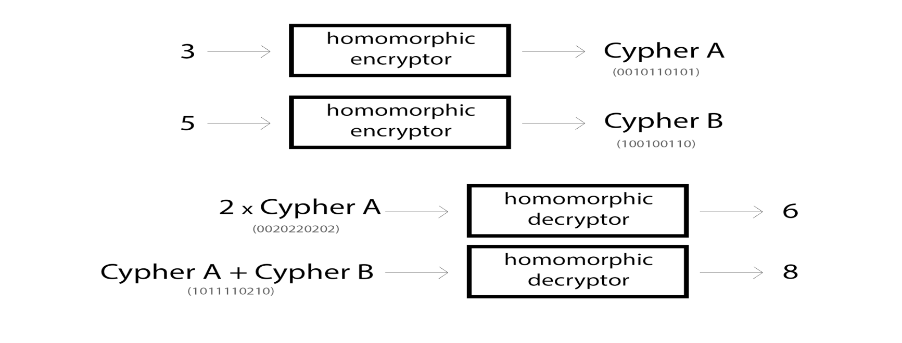
One Possible Solution: Homomorphic Encryption
What is Homomorphic Encryption?
Homomorphically encrypt the user gradients so that the gradient privacy is preserved
Privacy-Preserving Deep Neural Network model (2P-DNN) based on the Paillier Homomorphic Cryptosystem could be used to enhanced global model privacy
Hence there is no issue of theft or privacy intrusion in this case

Slide 13
Reward Calculation
Possible way
Based on user model performance on validation set
To evaluate the validity of user data, we can run a validation check on the user model based on a trusted validation set.
Based on the performance on validation set, the users can be rewarded.
If the validation accuracy goes below a specified threshold, the data is rejected.
Pros
An easy and fast way to calculate user reward immediately after client side training
Cons
At any given iteration, an honest gradient may update the model in an incorrect direction, resulting in a drop in validation accuracy.
This is confounded by the problem that clients may have data that is not accurately modeled by our trusted validation set

Slide 14
Issues with data in FL
What can go wrong?
Gamber attack
User/Attacker can randomly pick data and maliciously change them
User can give garbage input
User/Attacker give data that does not contribute to the model
Omniscient attack
Attackers are supposed to know the gradients sent by all the workers
Use the sum of all the gradients, scaled by a large negative value,
And replace some of the gradient vectors.
Gaussian attack
Some of the gradient vectors are replaced by random vectors sampled from a Gaussian distribution with large variances.

Slide 15
How to counter adversaries?
Possible ways
Based on KRUM Algorithm
Uses the Euclidean distance to rank the gradients
Determines which gradient contributions are removed
the top f contributions to the client model that are furthest from the mean client contribution are removed from the aggregated gradient
Pros
specifically designed to counter adversaries in federated learning.
Cons
Not an absolute measure of user contribution
Implementation is a bit complicated

Slide 16
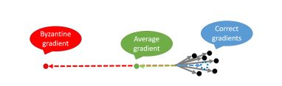
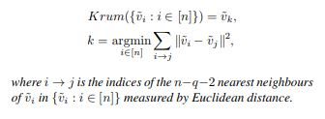
How to ensure validity of gradients?
Possible ways
Let us assume that q out of n vectors are Byzantine/incorrect, where q < n:
Expected average gradient
Krum’s Algo in a nutshell:
Works only when q < n
Ensure upto 33% protection against adversarial attacks
Best solution proposed till date

Slide 17
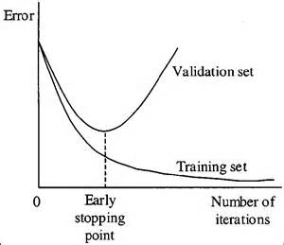
Proposed Solution to the User Reward Issue
Data Cost
Each User calculates his/her data cost
Class id – Ci, Number of samples - Nci
Cost per user -> ∑j=1 to k (j*Nci)
Generate validation set
Based on parameters passed to calculate data cost
Automatically generate a validation set with some random samples
Samples pertain to user specified classes
Training
Stop training before the model over-fits data
If validation error doesn’t go down, user entry is wrong
If validation error goes down, user entry is valid and pay the user based on calculated data cost

Slide 18
2
To Do: Causal Learning
How can Causal Learning help FL?
Issues?
Possible solutions

